Slide 1
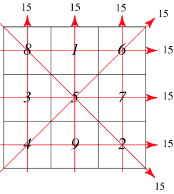

მაგიური კვადრატი
წყარო : wolfram
თორნიკე კიკაჩეიშვილი

Slide 2
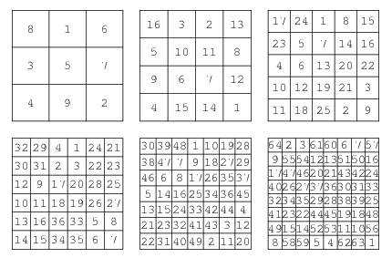
Lo Shu : 3X3
Dürer's magic square : 4x4

Slide 3
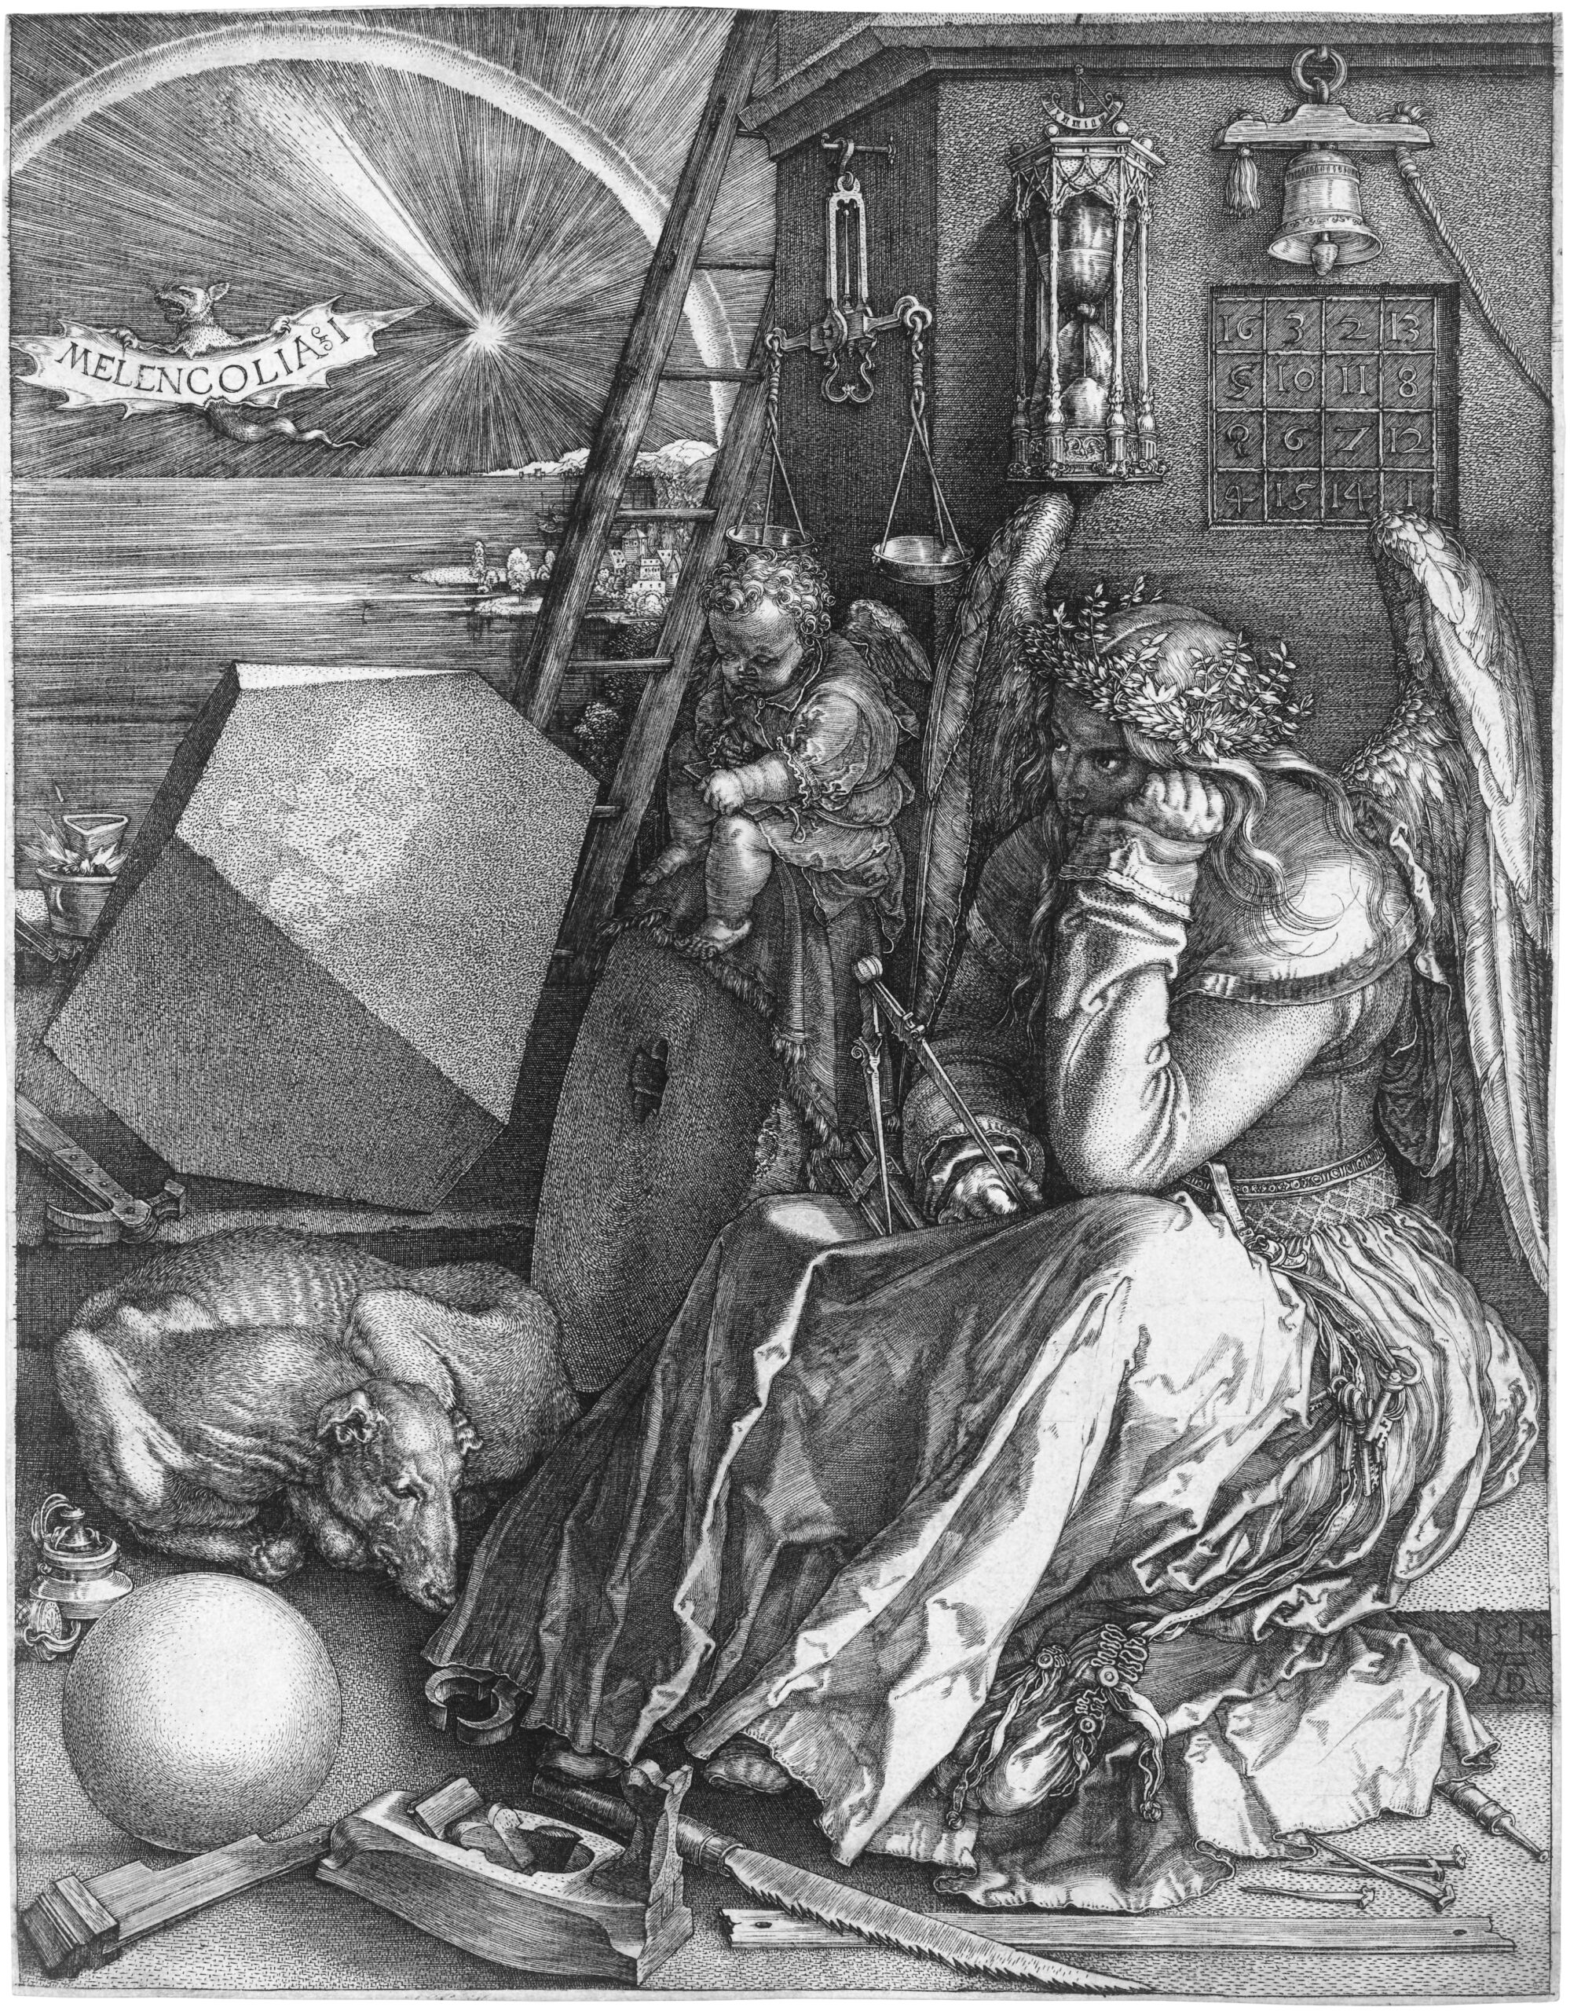
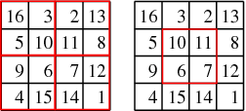
Dürer's magic square 34
gnomon magic square
1514
engraving entitled Melancholia I by Albrecht Dürer (The British Museum, Burton 1989, Gellert et al. 1989)

Slide 4
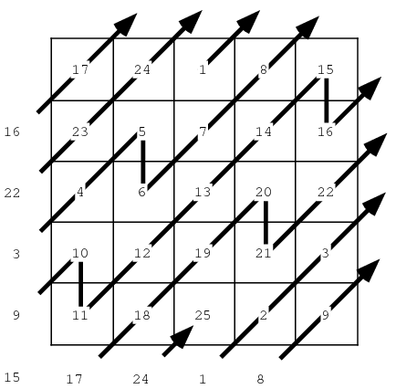
Types
4x4 : 880 Frénicle de Bessy in 1693
5x5 : R. Schroeppel in 1973
6x6 : not known (Pinn and Wieczerkowski (1998))
using Monte Carlo simulation
Semimagic square
Panmagic square
Bimagic square
Trimagic square
Associative magic square
Multiplication magic square
Addition-multiplication magic squares
Siamese Kraitchik 1942

Slide 5
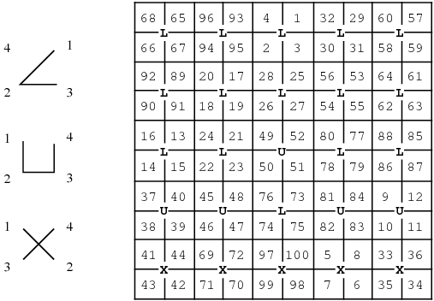
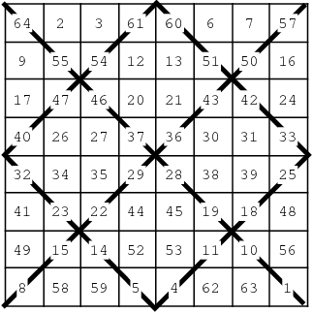
4EVEN & 4m+2

Slide 6
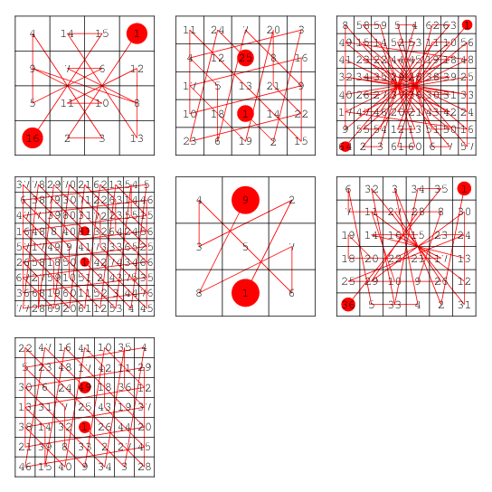
სიმულაცია

